Slide 1
Global Sales Planning & Analytics Associate - NV Sales Ops
Case Study
Name of Presenter: Arpita Rawal

Slide 2
Lead Prioritization framework
4.
Determine a minimum qualification score
Attributes
2. Identify customer behavior
Score Assignment
Data Technology
6. Refine and adjust your scores
The demographic, age group, gender, internet literacy, language (Scalability) to disqualify the extra leads.
Assigning the points-based – the newer with fewer points, the lead with items in the cart, Chatting with a bot or sales rep gets more points
Developing a system to have one source of truth, centralized Datawarehouse, user friendly for the sales rep. Creating grouping based on attributes.
1. To define customer criteria
3. Assign point values to each action
5. Using a lead scoring tool & Machine learning
Monitoring
Categorization
Continuous Improvement
Visit an app, click on ad -> Subscribe, promotional offers, monitoring lead's interest/activity, account creation -> Zip code, birthdate, family details
If a website visit is one point, subscribing to the email list is two, participating in a webinar is four and reaching out for a consultation is seven, so our minimum qualification score can be determined
Finding ways to redefine the system with more data and lead information based on past success
Source: Forbes

Slide 3
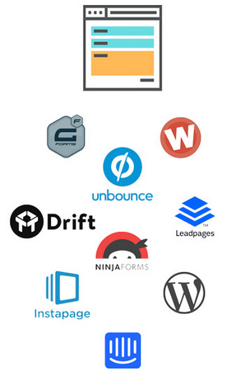
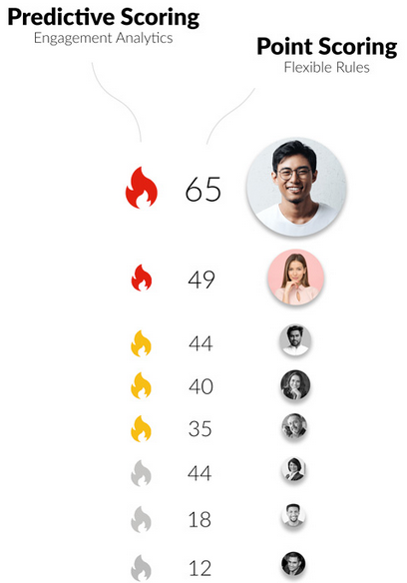
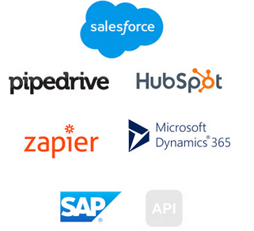
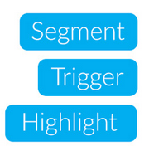
5. Using a lead scoring tool & Machine learning
Data Collection, Cleaning, Pipeline Creation
Scoring & Forecasting
Integration with CRM
Auto Tagging to Contact

Slide 4
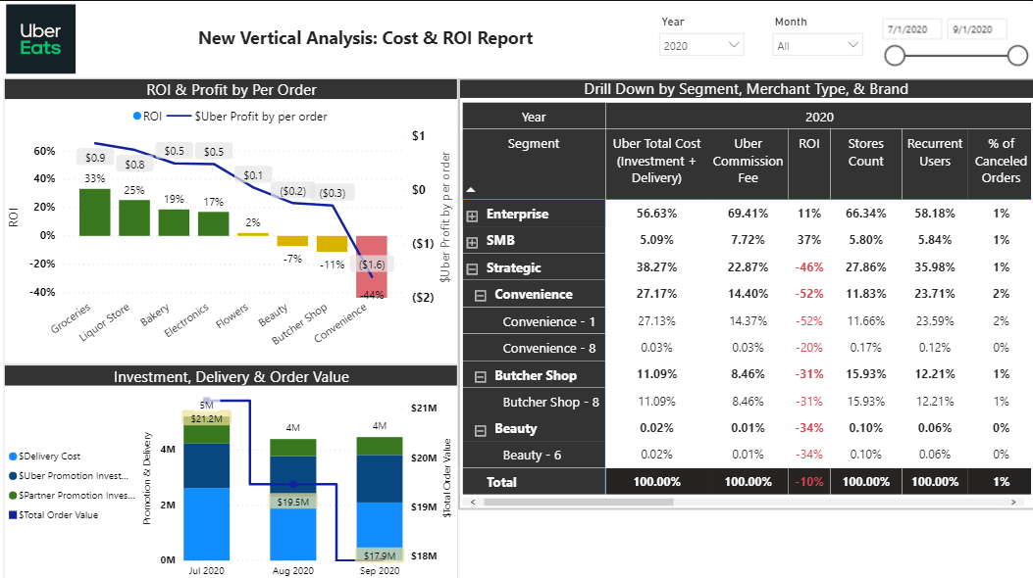
1. Determine the best and worst-performing merchants
2. Identify trends in the data
3. Solve additional business questions you want to address
Link to Dashboard
Insights:
The best results we received are from Groceries with 33% ROI followed by Liquor store with 25% ROI.
However, the best Merchant in terms of total revenue was Liquor Store ($0.5M & 3rd largest set of orders) followed by Groceries ($0.2M).
Convenience with -44% ROI is the worst performing Merchant but has potential to improve with the maximum number of Recurrent users and 2nd largest order count.
Total order value dropped by $3.3M (July to Sep). One reason for this drop is reduced promotion costs, mainly from the Partner's side.
Next Best Action:
To work with Strategic Segment and analyze customer survey ratings. Strategic has 35% of total recurrent users but
-46% of ROI.
The delivery cost has not been reduced as much as the total order value, which implies that delivery cost has increased. We need to revisit the delivery cost reduction plan and orders specific delivery data to focus.
Assumption-
Commission is only received on completed orders.
All orders are for online sale for customer.

Slide 5
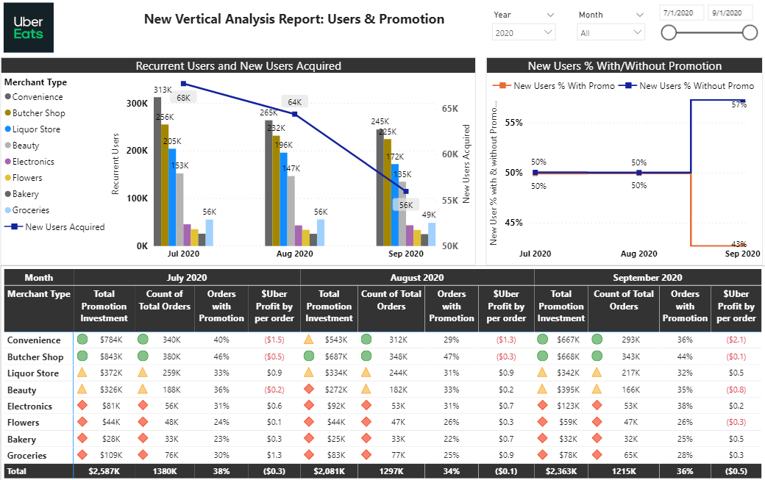
1. Determine the best and worst-performing merchants
2. Identify trends in the data
3. Solve additional business questions you want to address
Link to Dashboard
Insights:
The reduction in promotion investment by around $500K from July to August aligns with the New user count drop.•
7% more new users came without promotion, reflecting the expansion of branding and referral + promotion investment from previous months.
The recurrent users also dropped by around ~8% after July, mainly impacted by Convenience in Aug, Liquor store, and Groceries in Sep.

Slide 6
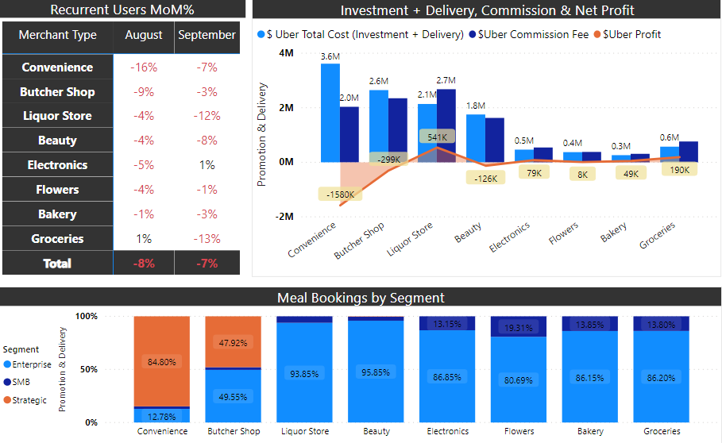
a. The identification of the best merchant?
Link to Dashboard
Identification of best Merchant –
Merchant with less delivery cost and comparatively more the commission, which helps to increase the overall Net Profit.
Merchant with more enterprise segment customers.
Merchant with less reduction in recurrent users and shows growth in acquiring new users.
Merchant with less than 1% of order cancelation and maintain the demand-supply chain.
Merchant who takes the initiative in Marketing, Advertisement, and Partner’s Promo Investment.
Having Store with no or fewer competitors nearby.
Which has stores in the various county for easy brand recognition and gaining customer trust.
Stores with good net promotor customer score and minor detractor.
Friendly staff, follows CDC safety protocol.

Slide 7
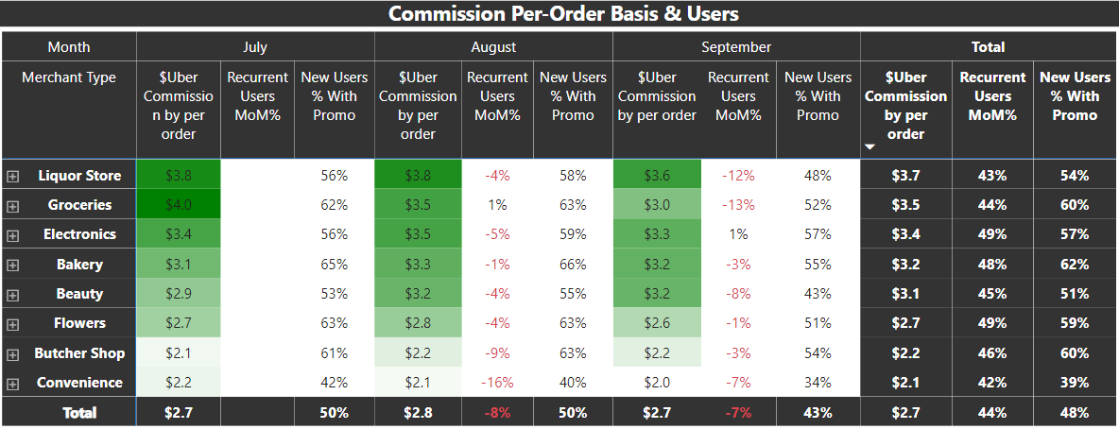
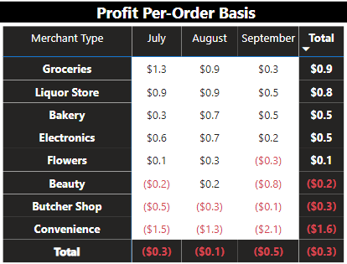
Link to Dashboard
b. Who provides the best commissions on a per-order basis?
Based on the average of the last three months and the previous month, the best commission per order is received from Liquor Store followed by Groceries.
Liquor Store has comparatively less number of orders than Butcher shop or Convenience, still provides highest total commission due to its high per-order $ commission.
Assumption-
Commission is only received on completed orders.
All orders are for online sale for customer.
Next Best Action –
Liquor Store and Groceries are the top 2 Merchants in terms of commission or profit per order. However, their recurrent users rate dropped by around 12% in September, so we need to dig more into customer survey data, the quality of products, and keeping up with trends and safety protocols. (Completed orders % has not dropped).

Slide 8
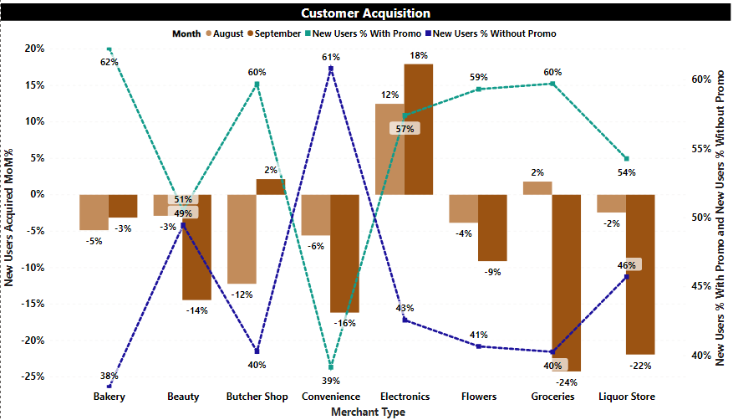
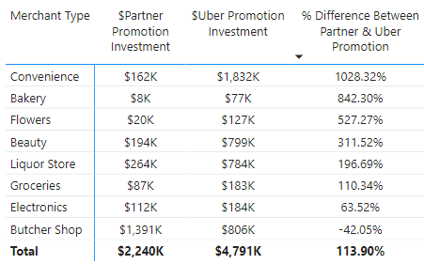
c. Who has accelerated the most on customer acquisition?
Link to Dashboard
Electronics have accelerated the most in customer acquisition. MoM had shown growth of 12% and 18%.
57% of the newly acquired customers were part of the promotional acquisition, and the remaining 43% came without a promo.
Also, Electronics is the only merchant with growth in Recurrent Users MoM% in September.

Slide 9
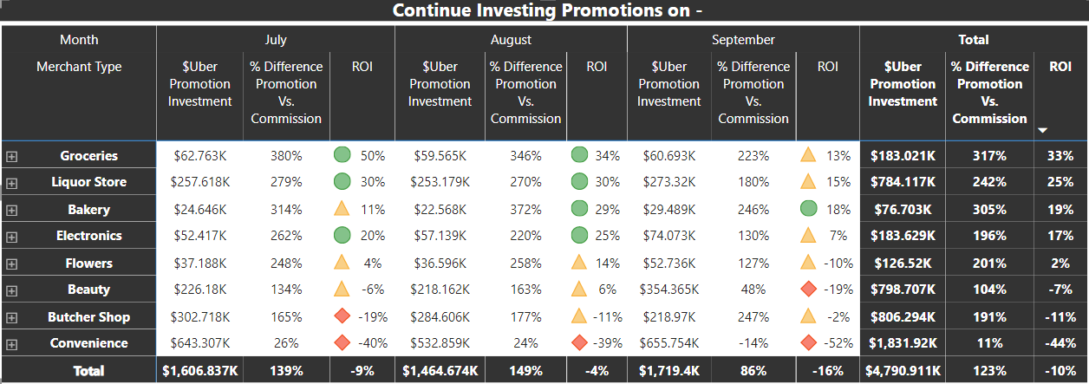
d. Which merchant should we continue investing promotions on?
Link to Dashboard
Groceries has a % difference of 317% between Commission vs. Promotion Investment, and even when we include the delivery cost, the highest ROI among all categories is from Groceries at 33%.
Around 60% of the newly acquired users came from Promo.
Groceries is the only category with positive ROI from all the brands.
Out of the 13 brands under groceries, 11 are from the Enterprise segment (from where the overall order value is comparatively high).

Slide 10
Thank you
In case of any questions or data requirement, please feel free to reach out to Arpita Rawal at arawal@hawk.iit.edu

Slide 11
Appendix

Slide 12
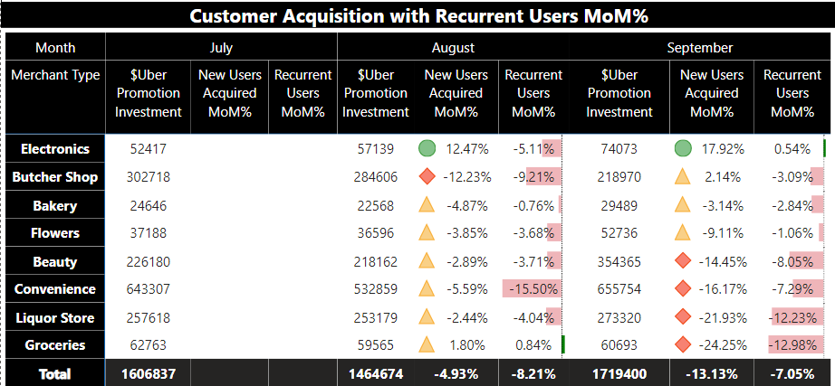

Slide 13
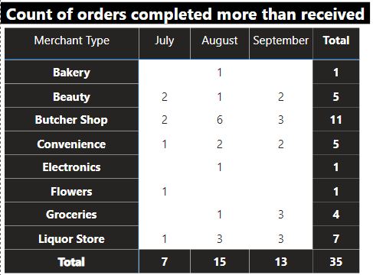
Questions to discuss -
Q.1 ) Why completed orders count is more than received orders ?

